Slide 1

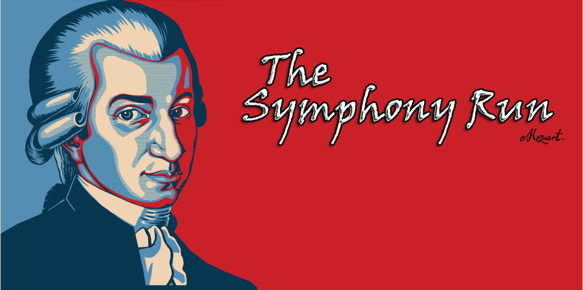


Marouen Abdi
Emerson Navarro
Gabriel Dario Chanchay Tituaña
Development of Games for Mobile Devices

Slide 2

The plan:
Player Character
Controls
Game Experience
Game World
Game mechanism
Collectibles
Future work
Monetization
Game Story
Inspiration

Slide 3
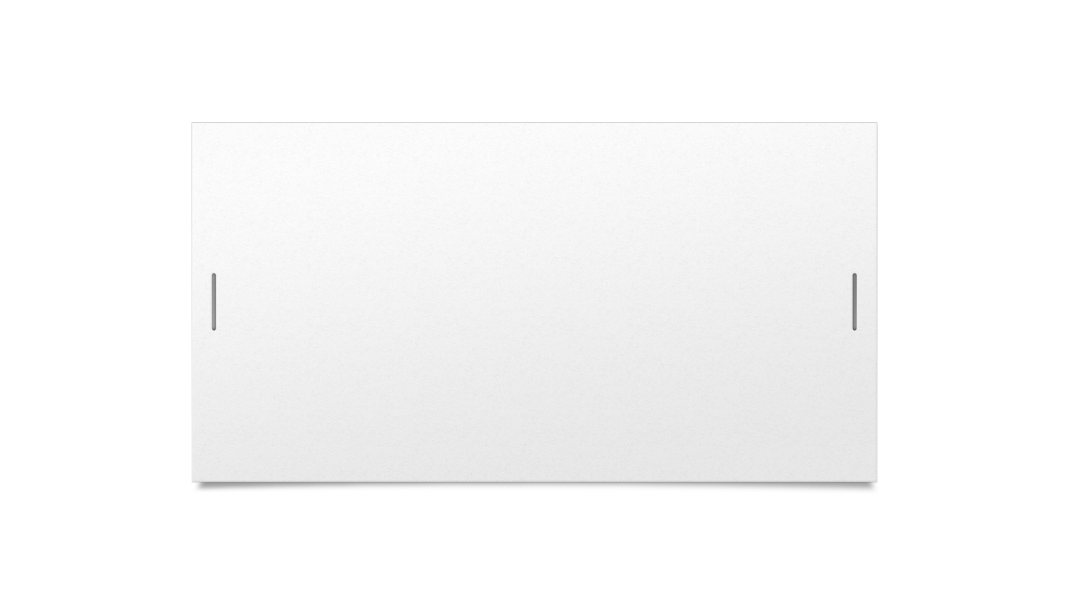
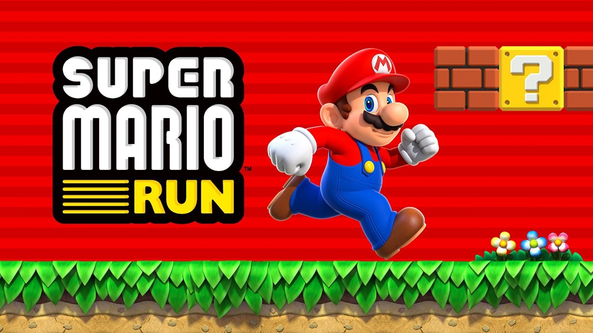

Inspiration
runner games

Slide 4
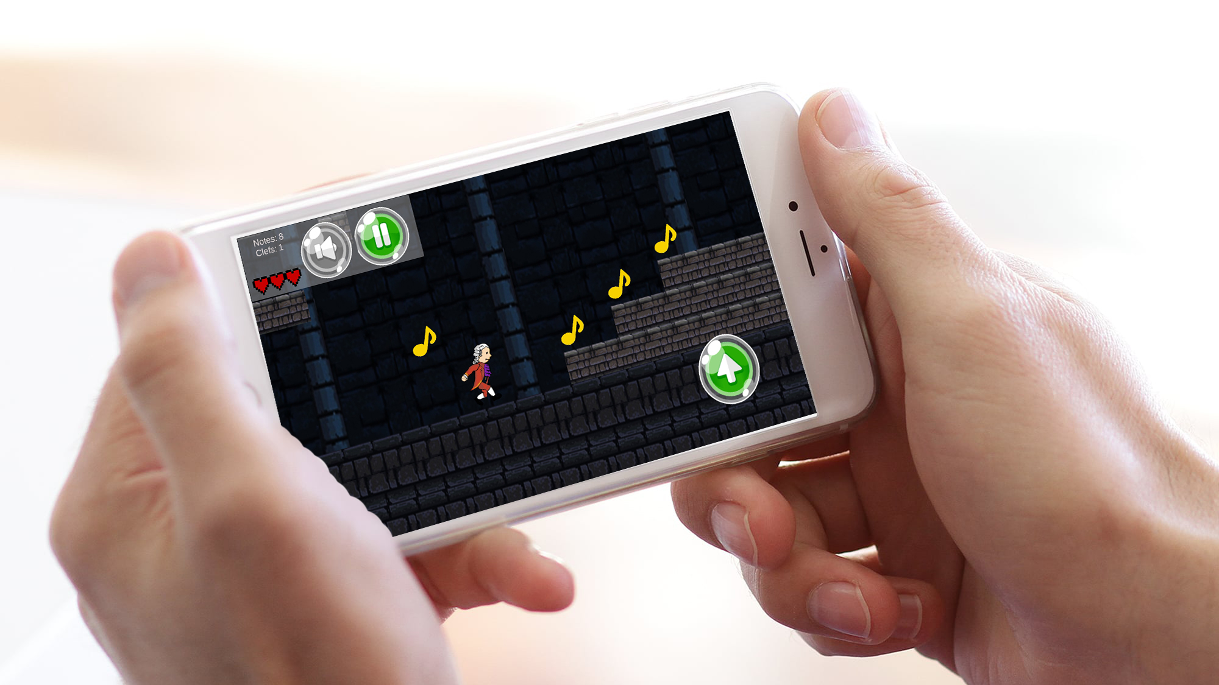
Game Story

Slide 5

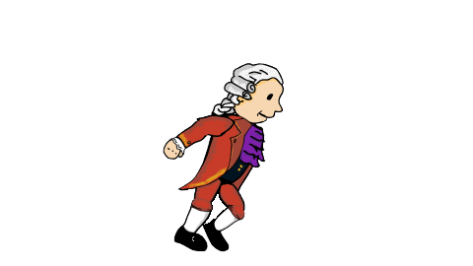
Player Character

Slide 6
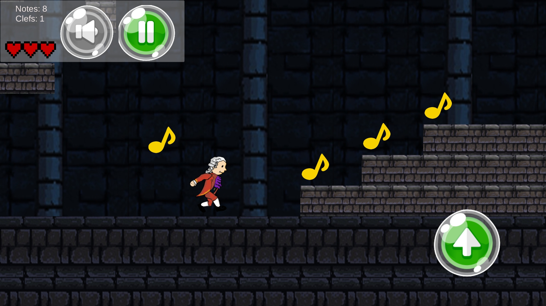
Controls

Slide 7
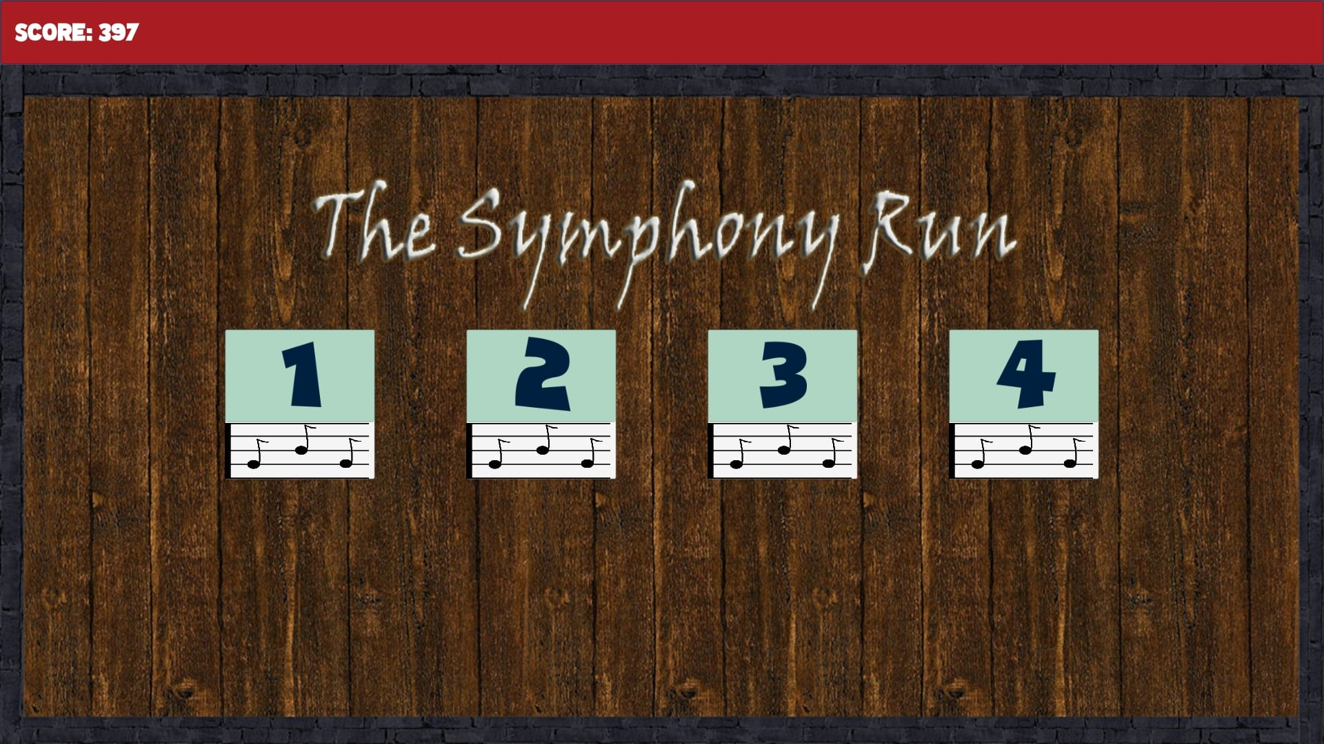
Game Experience
Our game is made of 4 levels
Screenshot of the menu

Slide 8
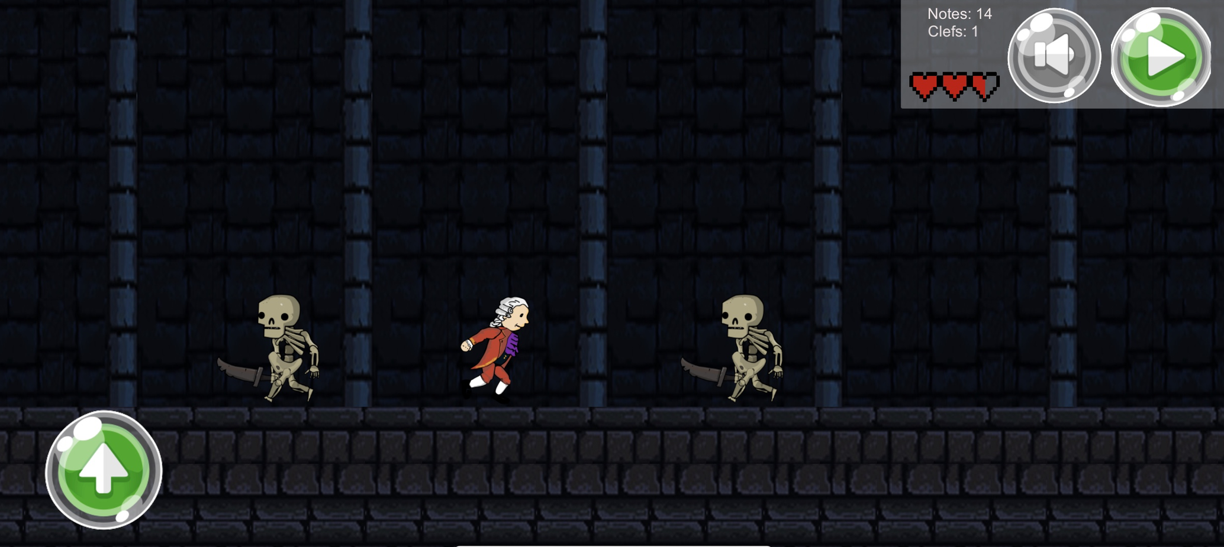
Game World
….

Slide 9
Music
Level 1: Turkish March.
Level 2: Le nozze de Figaro.
Level 3: Magic Flute.
Level 4: Symphony 40 in G minor.
Waiting music: Piano concert N 21.
Dead Music: Requiem Lacrimosa.
….

Slide 10
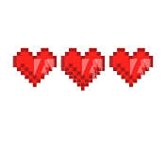

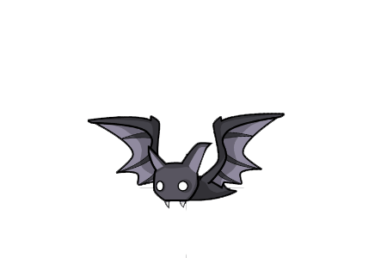
Game mechanism
-
-

Slide 11


Collectibles
The score of every game will be saved and the player will have more score if he collect more notes in the game.
Normal note (Yellow) = +1
Special note (Red) the player need to collect the 3 red notes of each level to unlock the next one.

Slide 12
Future work:
We plan on supporting The Symfony Run with at least 6 months of downloadable content that expands on the existing game:
New cities
New enemies
New outfits for Mozart
New symphonies
More levels
Weapons for Mozart
Christmas theme
Multiplayer mode (Online/offline)
Ability to buy premium items
More surprises...

Slide 13

Monetization
The game will be free, but the player will be able to buy new outfit for Mozart and new environments.

